Slide 1

Restaurant Analysis
By - Md Javed Momin

Slide 2
Top 3 Cuisines
Cuisines Name | Count of Cusine | Restaurants %
Indian | 4259 | 44.59
North Indian | 3960 | 41.47
Chinese | 2733 | 28.62

Slide 3
City Analysis
Identify the city with the highest number of restaurants in the dataset → New Delhi
Determine the city with the highest average rating →Inner City

Slide 4
Price Range Distribution
Price Range Category | Count of Restaurants | Restaurants %
1 | 4444 | 46.53
2 | 3113 | 32.59
3 | 1408 | 14.74
4 | 586 | 6.14

Slide 6
Online Delivery
Percentage of restaurants that offer online delivery → 2451
Average Rating with Online Delivery → 3.38
Average Rating without Online Delivery → 3.47
Restaurants without Online Delivery are slightly higher rated than Restaurants with Online Delivery.

Slide 7
Restaurant Ratings
Most Common Rating Range : Average Rating
Average number of votes received by restaurants : 156.91

Slide 8
Restaurant Ratings
Rating Range | Count
Average | 3737
Not rated | 2148
Good | 2100
Very Good | 1079
Excellent | 301
Poor | 186

Slide 9
Cuisine Combination
Most Common combinations of cuisines in the dataset : North Indian, Chinese

Slide 10
Determine if certain cuisine combinations tend to have higher ratings?
Cuisines Combination | Count | Ratings
Sunda, Indonesian | 3 | 4.9
American, BBQ, Sandwich | 1 | 4.9
American, Burger, Grill | 1 | 4.9
American, Caribbean, Seafood | 1 | 4.9
American, Coffee and Tea | 1 | 4.9
American, Sandwich, Tea | 1 | 4.9
BBQ, Breakfast, Southern | 1 | 4.9
Burger, Bar Food, Steak | 1 | 4.9
Continental, Indian | 1 | 4.9
European, Asian, Indian | 1 | 4.9
European, Contemporary | 1 | 4.9
European, German | 1 | 4.9
Hawaiian, Seafood | 1 | 4.9
Italian, Bakery, Continental | 1 | 4.9
Italian, Deli | 1 | 4.9
Mexican, American, Healthy Food | 1 | 4.9
Mughlai, Lucknowi | 1 | 4.9

Slide 11
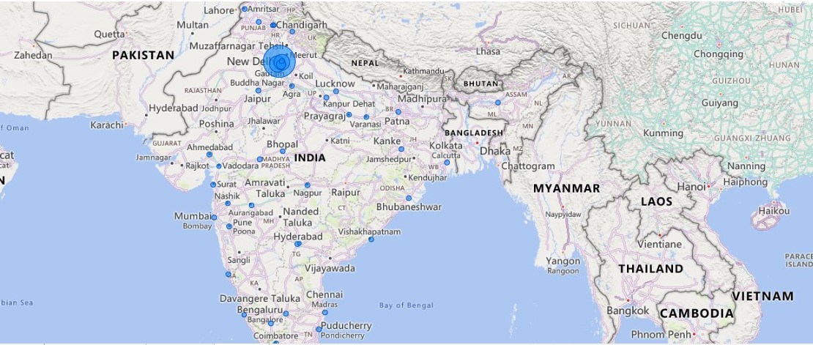
Geographical Analysis

Slide 12
Restaurant Reviews

Slide 13
Correlation Analysis
Analyze if there is a correlation between | 0.313690584
the number of votes and the rating of a
restaurant.

Slide 14
Votes Analysis
A correlation coefficient of 0.3136 indicates a positive correlation between the number of votes and the rating of a restaurant. However, the strength of this correlation is considered to be relatively weak.
The positive sign indicates that as the number of votes increases, the rating tends to increase as well.
The value of 0.3136 suggests that there is a positive relationship between the two variables, but it's not very strong.
In summary, while there is a tendency for restaurants with more votes to have higher ratings, the correlation is not strong, indicating that other factors may also influence the ratings of the restaurants.

Slide 16
Price Range vs. Online & Table

Slide 17
Price Range vs. Online & Table
Based on the analysis, there appears to be a relationship between the price range of restaurants and the availability of online delivery and table booking. Here are the key findings:
1) As the price range increases, the percentage of restaurants offering both online delivery and table booking tends to increase.
2) Lower-priced restaurants (Price Range 1) have the lowest percentage of offering both services, at approximately 0.0225%.
3) Higher-priced restaurants (Price Range 3 and 4) have relatively higher percentages, with Price Range 3 showing around 19.2472% and Price Range 4 showing approximately 6.8259%.

Slide 18
Price Range vs. Online & Table
This suggests that there is a correlation between price range and the availability of these services. Higher-priced restaurants are more likely to offer both online delivery and table booking compared to lower-priced ones. However, it's important to note that there may be exceptions or variations within each price range, and other factors could also influence the availability of these services.
Also, Based on the analysis, it does appear that higher-priced restaurants (Price Range 3 & 4) are more likely to offer online delivery and table booking services compared to lower-priced ones (Price Range 1 & 2)

Slide 19
THANK YOU !!!

